Slide 1



Synthetic Aperture Radar Imager
ECE Team 11
MEMBERS:
SCOTT NICEWONGER
KEGAN STACK
OLIVIER BARBIER
JULIAN RODRIGUEZ
JORDAN BOLDUC
SPONSOR: NORTHROP GRUMMAN
ADVISORS: DR. SIMON FOO
DR. SHONDA BERNADIN
DR. RAJENDRA ARORA
INSTRUCTOR: DR. JERRIS HOOKER
DATE: 3/25/2016

Slide 2
  Project Overview &
  Theory of Operation
Scott Nicewonger, Project Manager

Slide 3
Agenda
SAR Introduction
Scope
Signal Processing
FPGA Code & Control Considerations
Structure & Horn Holders
Component Housing & Migration
Progress & Schedule
Scott nicewonger

Slide 4
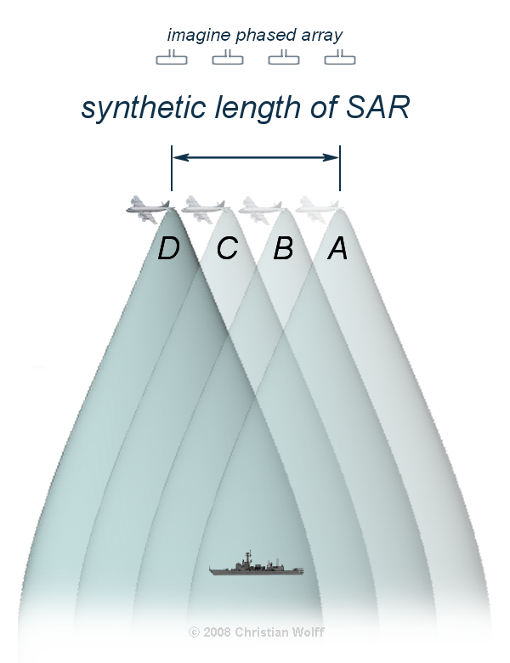
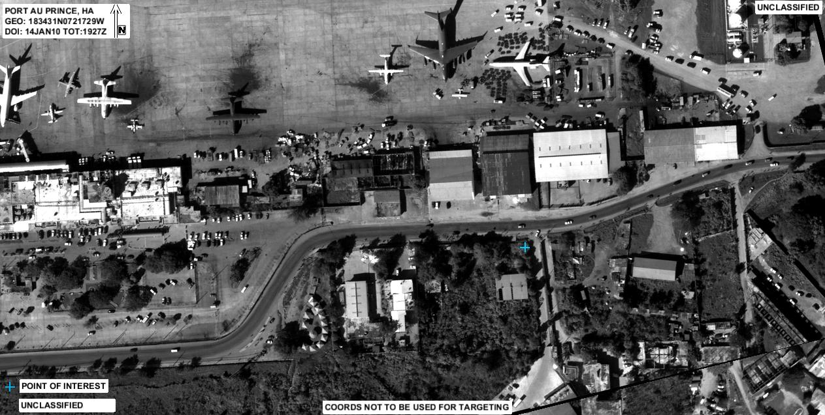
SAR Introduction
What is an SAR?
Synthetic Aperture Radar: Typically, a single antenna is attached to an aircraft flying over a target zone capturing several wide-beam images, and combines them into a single, high-resolution, narrow-beam image.
Scott Nicewonger

Slide 5


Real Transmitter
TX
Synthesized Transmitter/Receiver
with Aperture Length d
TX / RX
d
Phase Center
$$≈$$
Reflective Target
RX
Real
Receiver
SCOTT NICEWONGER

Slide 6
Stationary Scanning
1-D Side View
Front View
TX
PC 1
RX₁
TX
RX
PC 2
RX
Phase Centers are formed at the midpoint between each transmitter/receiver pair
Pulsing a linear array of receivers enables a scan of the target area without any moving parts
Imager consists of linear arrays in X and Y axes to scan the entire scene
RX
PC 3
RX₂
RX
PC 4
TX
RX
RX
RX
RX
RX
RX
RX
RX
TX
RX
RX
RX₃
RX
RX
TX
RX₄
SCOTT NICEWONGER

Slide 7


Phase Slope
θ
nd sin(θ_{n})
3d sin(θ_{n})
16 Phase Centers
16 θ_{n} ‘s that map to 16 unique regions in the scene
For each θn , a 16-point complex basis function is generated
Received data is convolved (DFT) with basis functions to map energy amplitude VS frequency
2d sin(θ_{n})
d sin(θ_{n})
d
R
$$≈$$
Downrange
Scene
θ_{n}
R $≈$Rcos θ
d = 3λ
SCOTT NICEWONGER

Slide 8
Scope
Objective
  Develop a static, multi-antenna Synthetic Aperture Radar (SAR) Imager
Application
Ultimately, for concealed weapons detection in security applications
Design
Proof of concept prototype
  Low Resolution
  Real-time not necessarily required
Generation II redesign
Scott Nicewonger

Slide 9
SCOTT NICEWONGER

Slide 10
Second Generation Design Goals
Electrical Engineering
Identify reflector at 20 feet
Standalone functionality
FPGA signal processing for real-time & standalone functionality
MATLAB signal processing for testing & future development
Mechanical Engineering
Mobility
Lower Weight
Horn Adjustment
Increase Stability
Scott nicewonger

Slide 11
Signal Processing
Jordan Bolduc

Slide 12
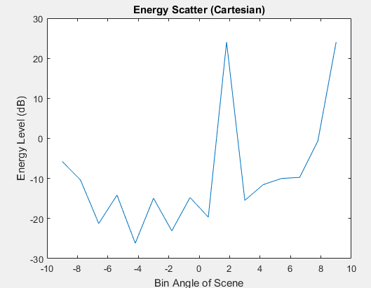
Completed
Signal processing algorithm is finished in MATLAB
Different visual representations are being used:
  Cartesian Plot
  Bar Graph (i.e. stripe on VGA display)
  3D Mapping of energy

Slide 13
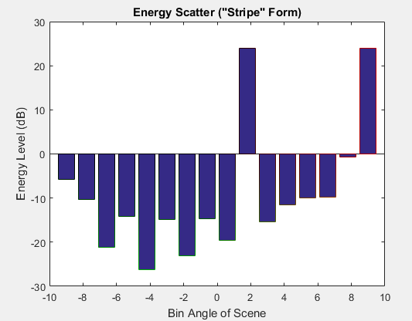
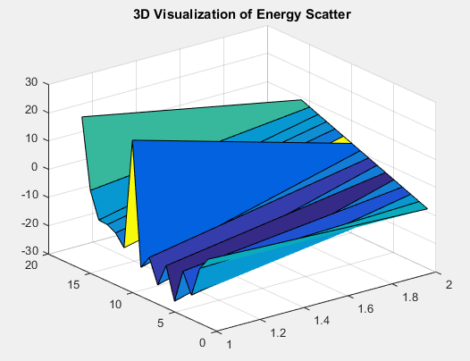
Data Visualization

Slide 14
Calibration Code
Why create calibration code?
  Corrects for the Far Field Assumption
  Going off and targeting at an angle
  Isolates the peak energy level
Two Methods
  Main Goal: Boresight Calibration
  Contingency Plan: Logical Indexing

Slide 15
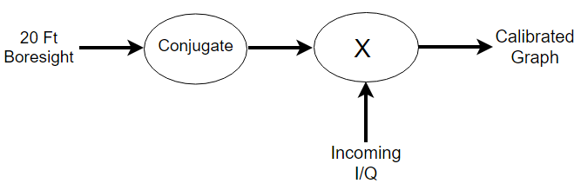
Boresight Calibration
Take raw data measurement 20 feet away at boresight
Multiply by complex conjugate of these numbers
Calibrate all the rest of incoming data with this conjugate to calibrate
Eliminates most of the far field assumption up to about 15 degrees from boresight
Not perfect, but works for the scope

Slide 16
Matrix Logical Indexing
Advantages
Can eliminate the noise floor
Sets all data to zero if below certain energy level
Should only show stripe in the bar graph
Can also be used for display purposes along with boresight calibration
Disadvantages
Not very accurate
Does not account for and take away large reflections that are detected
Must know energy expected energy level for detection

Slide 17
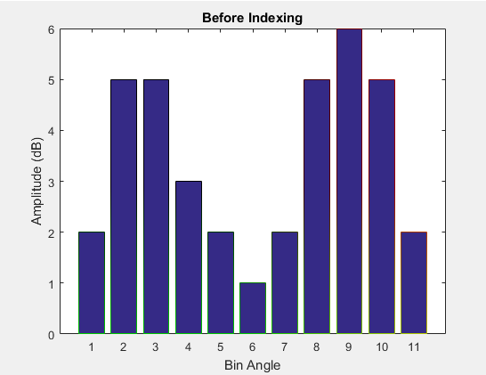
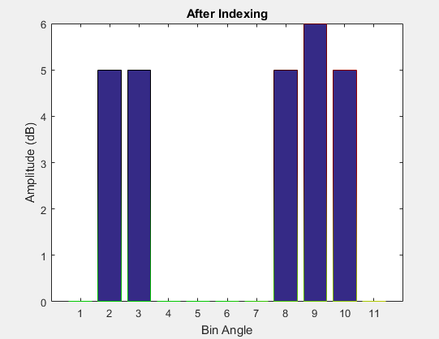
Matrix Logical Indexing
>> Data = [2 5 5 3 2 1 2 5 6 5 2];
>> Data(~(Data > 4)) = 0
Data =
0 5 5 0 0 0 0 5 6 5 0

Slide 18
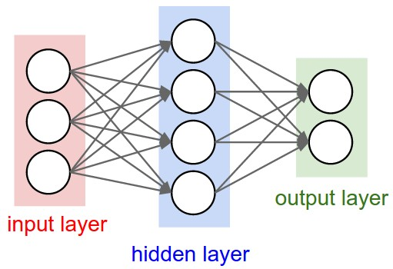
Neural Network
Still open to implementation
Time dependent
Can be worked on in between teams
3rd Generation Goal

Slide 19
  FPGA Code & Control Considerations
Olivier Barbier

Slide 20
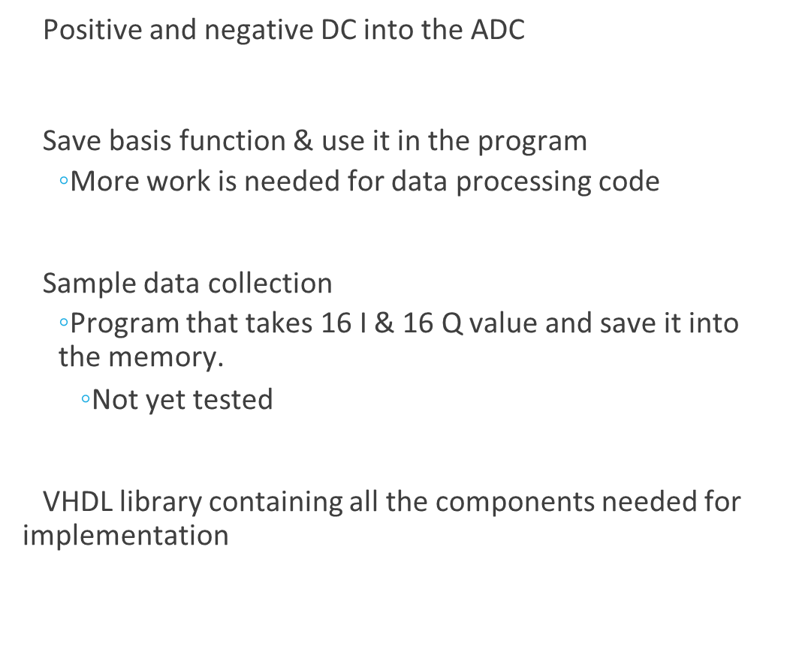
ACCOMPLISHED WORK

Slide 21
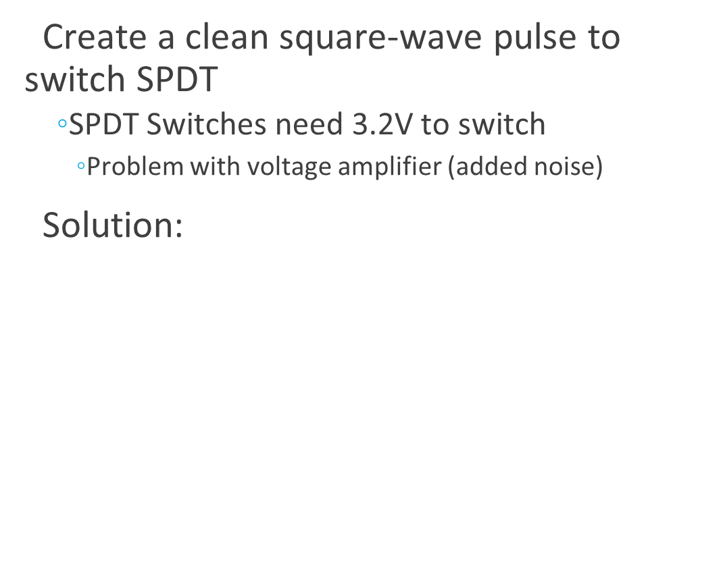
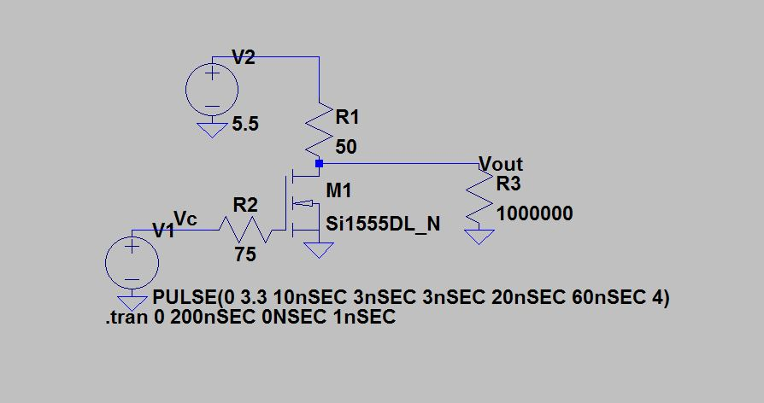
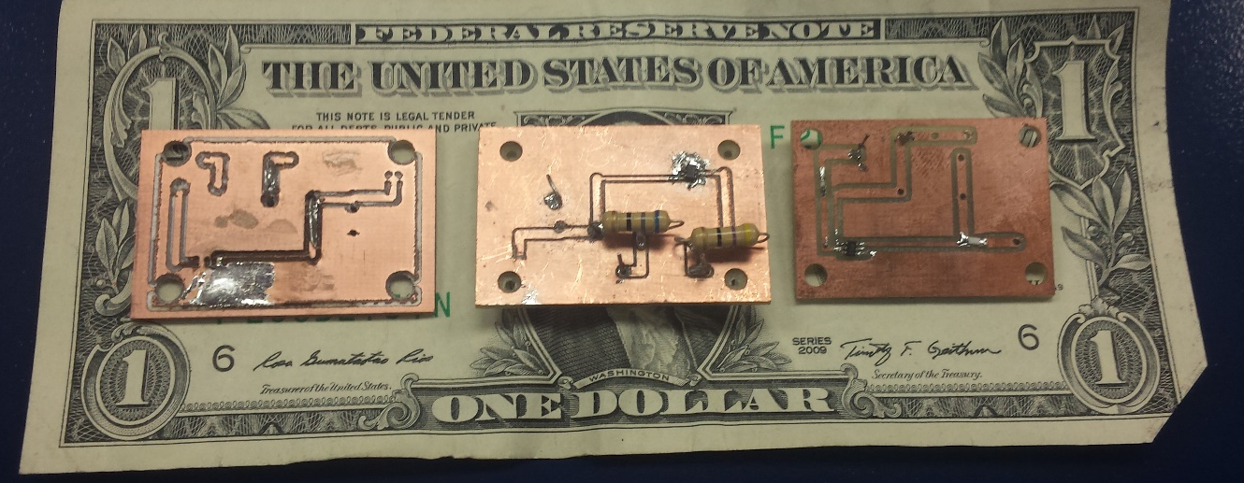
Problem Faced

Slide 22
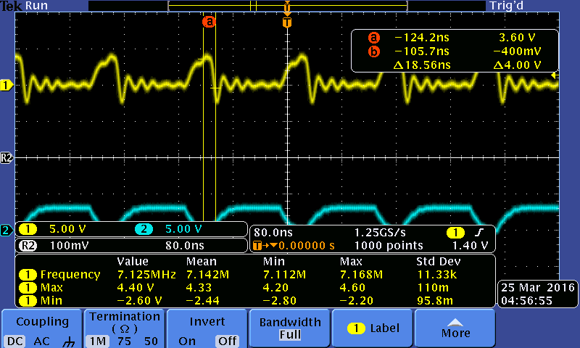
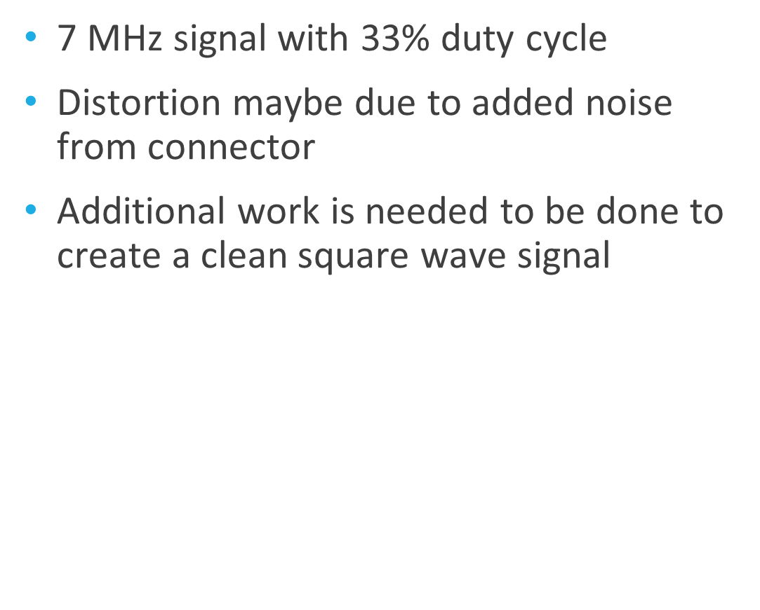
Problem Faced (continued)

Slide 23
Code Status
TRANSMIT AND RECIEVE PATH
  Manual control of switches
  Real time control of switches
Display
  Primary goal has been achieved
Data processing
  In progress
The coding is 75% complete

Slide 24
Structure & Horn Holders
Kegan Stack

Slide 25
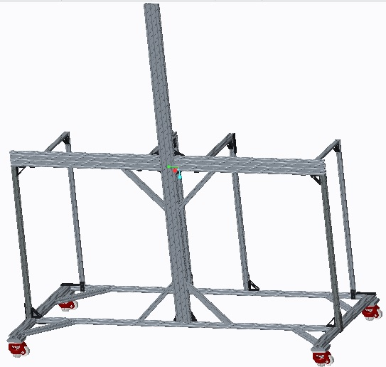
Structure Revision: Version 4
Weight reduced to 80lb goal
Introduction of leveling casters for alignment
Addition of gussets for extra support
Weight reduced to ~55 lbs
67”
30”
66”
Kegan stack

Slide 26
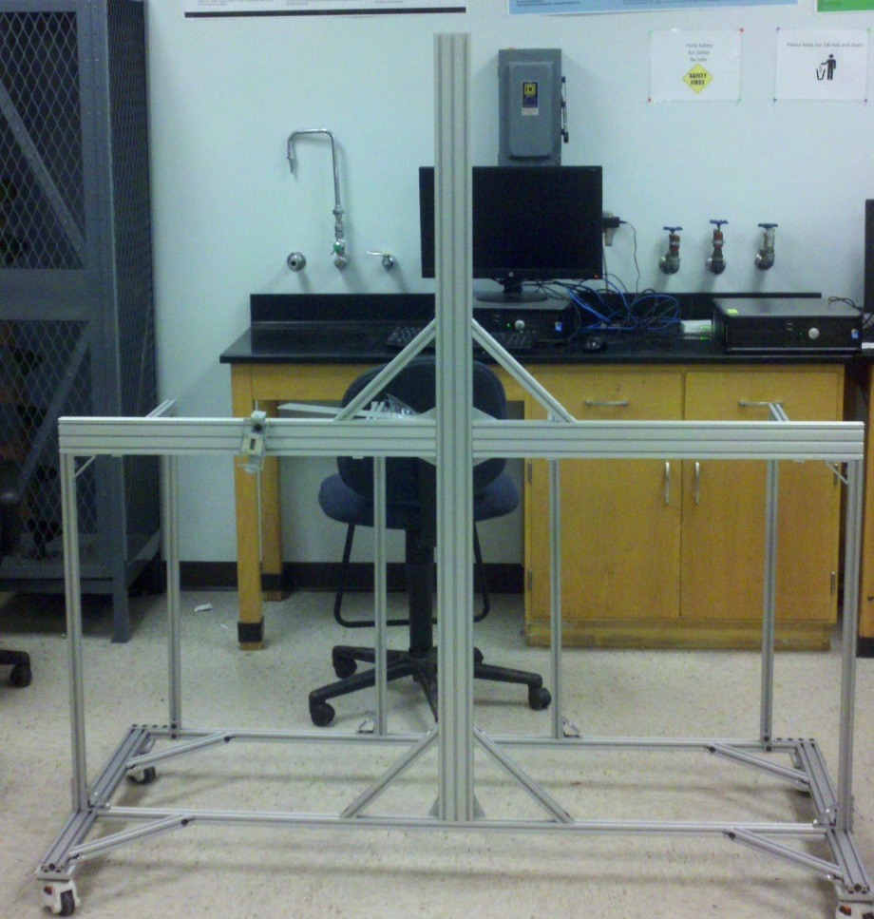
Structure Assembly
Physically assembled this version (4hrs)
Some noted challenges
  Leveling casters small 2” plastic wheel
  Slight bend in horizontal beam
  Front and back base beams oscillate independently if shook
Kegan stack

Slide 27
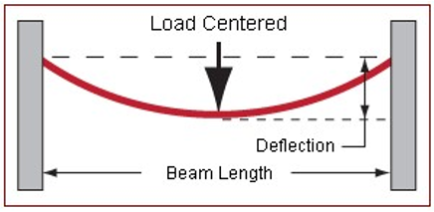
Structure Force Analysis
Performed a force analysis to check deflection and find improvements
Application of test force in center of beam with rigid endpoints
Force set to 20 lbs to account for the vertical beam and half of component box
Length set to 62”
Kegan stack

Slide 28

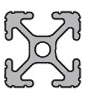
Structure Force Analysis Results
Original 1010
New 1020
Total Deflection: 0.0623 In
Total Deflection: 0.0098 In
6x less deformation
Kegan stack

Slide 29
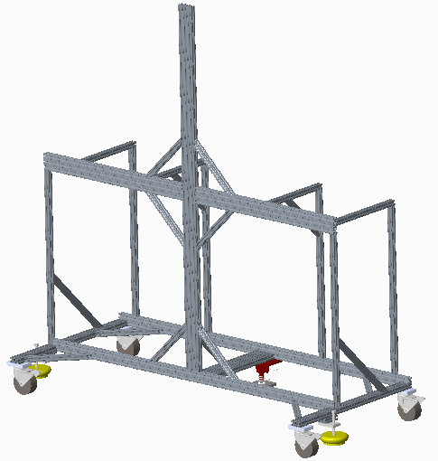
New Structure Revision: Version 5
Modification of current structure
  Weight no longer issue
  Goal is for a stable structure
Switch to rubber 4” casters
  No leveling caster presents alignment dilemma
  Solved with foot floor lock (red) and adjustable vibration feet (yellow)
More gussets added to stiffen the structure
Base pieces changed to 1020
1030 piece added to middle of base to join halves
Kegan stack

Slide 30
Horn Holder Design
Design Goals
  Independent axis adjustability
  Independent axis locking
  Lightweight
  Ease of adjustability and alignment
  No clearance issues
Kegan stack

Slide 31
Final Design Iteration
Removed clearance issues
Moved axis of rotation
Minor dimensional changes
Corrected T-nut series
Kegan stack

Slide 32
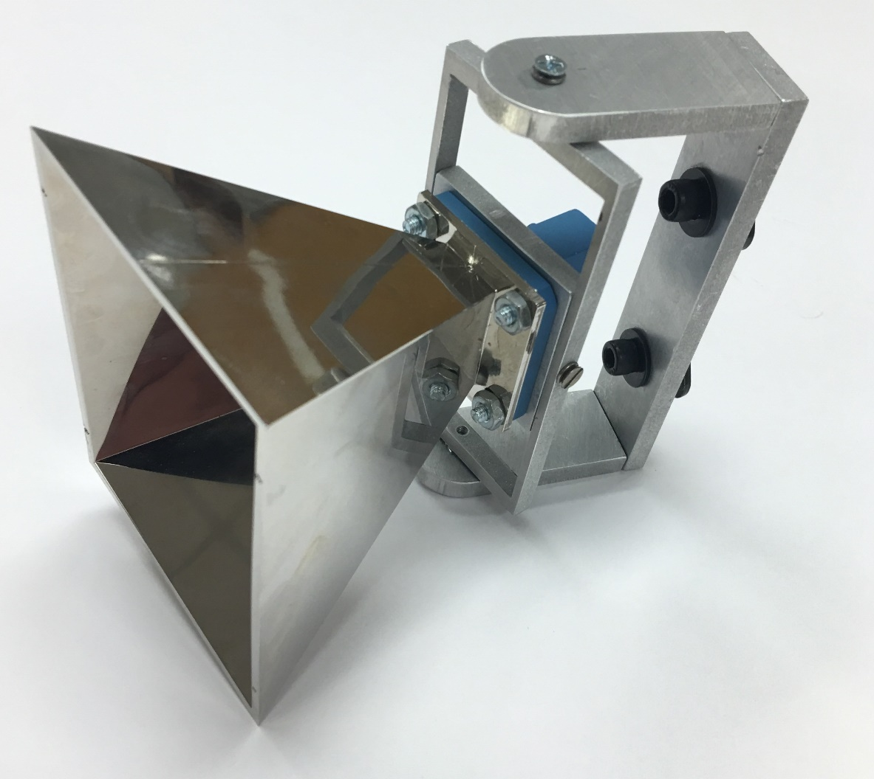
Horn Holder Prototype
2.5”
Status: Complete
  Optimized fastening method with thumb screws
  Additional tolerance added for star washer
Weight: 1.5lb
Cost: $15 per horn holder
What’s left?
  Install onto frame
1”
4.64”
Kegan stack

Slide 33
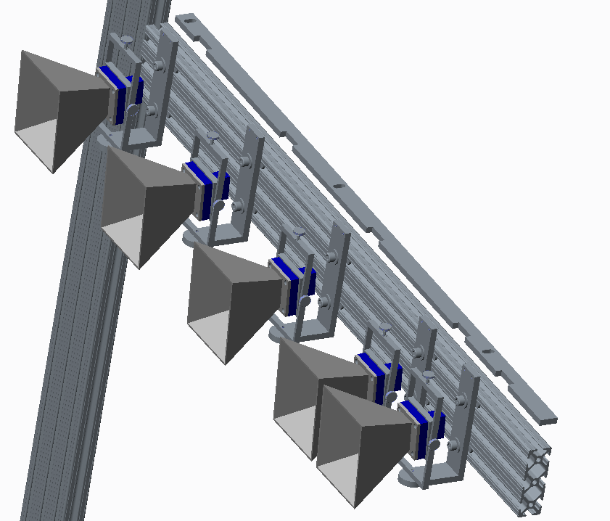
Horn Spacing - Jig
Simplest way to ensure exact horn spacing
  Compared to individual measurements
Jig made from 1/8” aluminum 6061
Cut in house with the water jet
  Accurate to within 0.003”
Measures from the intersection of the frame – out
Status: Completed
Jig
Kegan stack

Slide 34
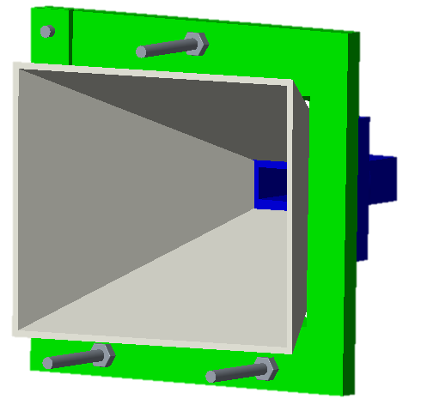
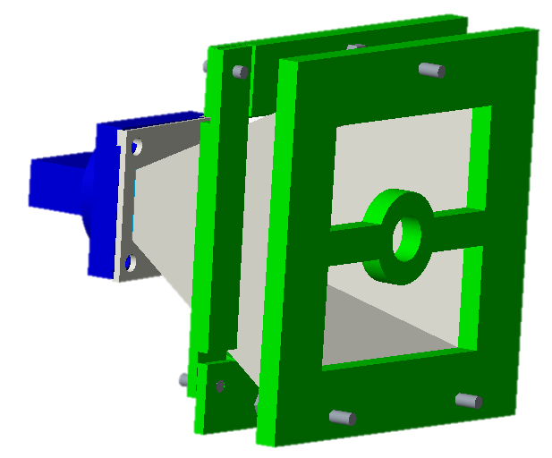
Horn Calibration – Option 1
Kegan stack

Slide 35
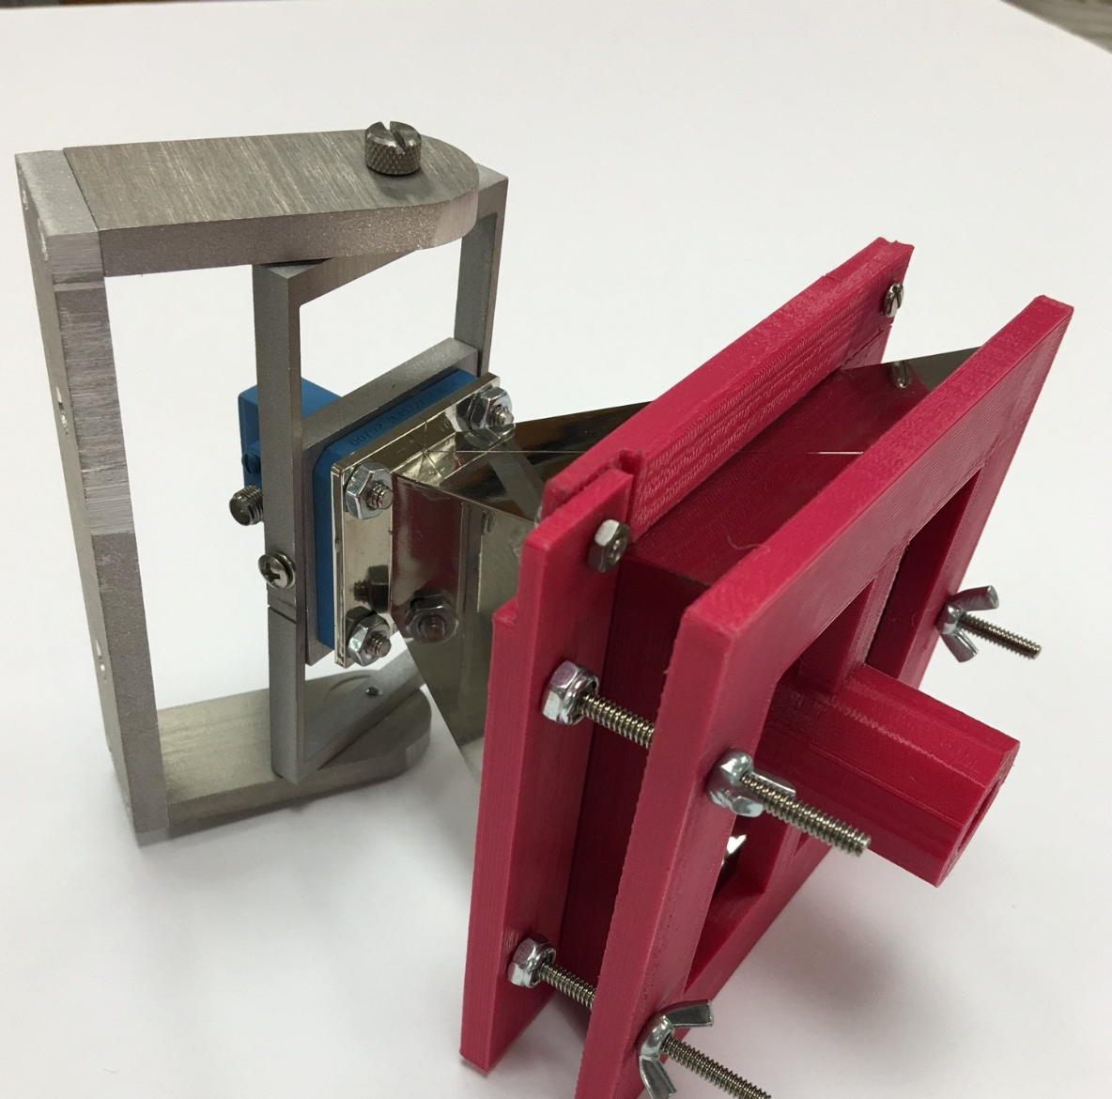
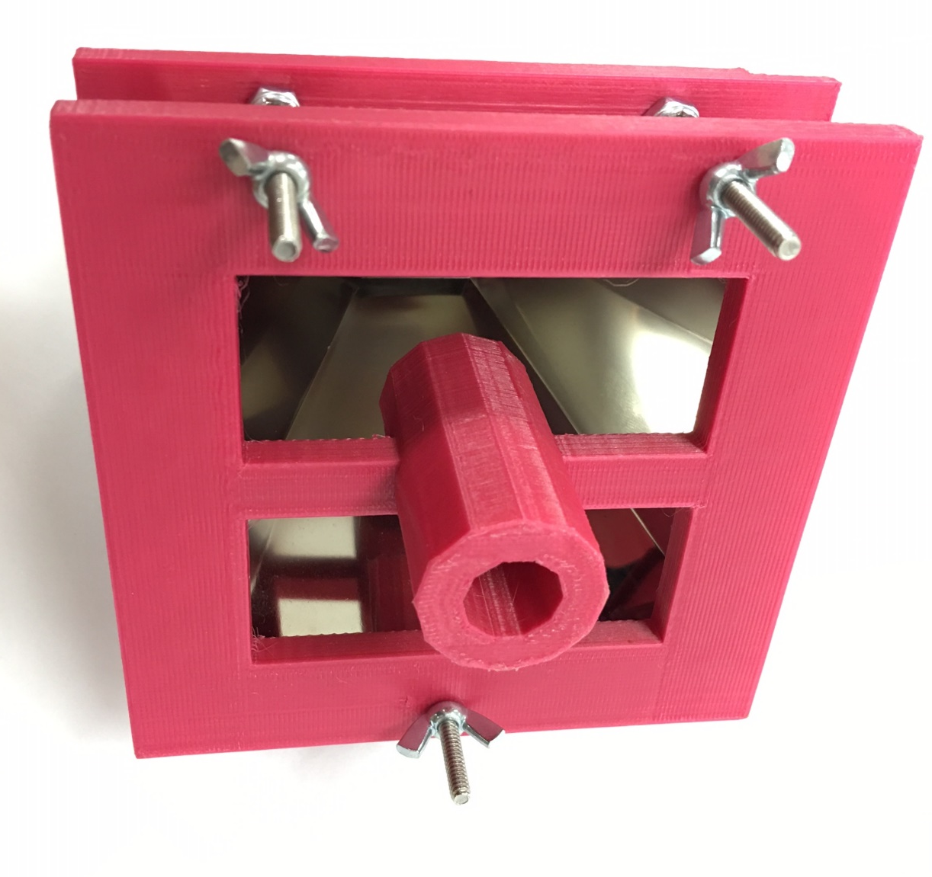
Kegan stack

Slide 36
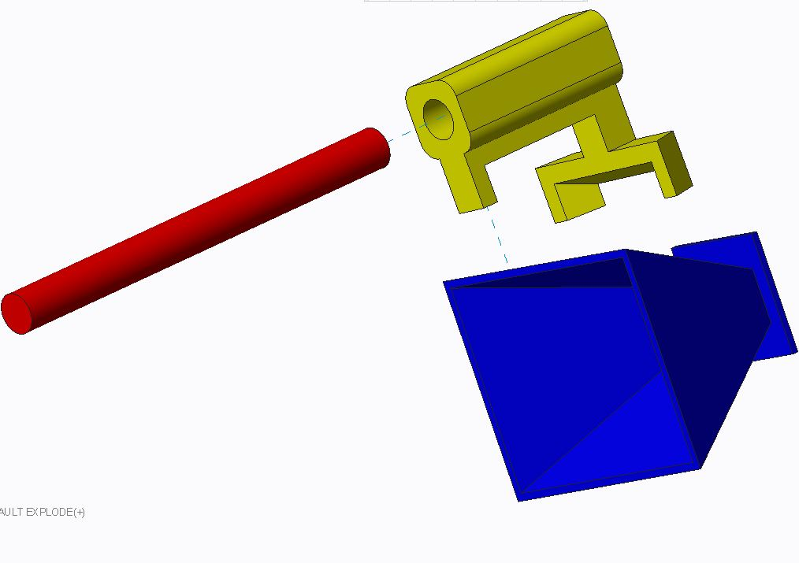
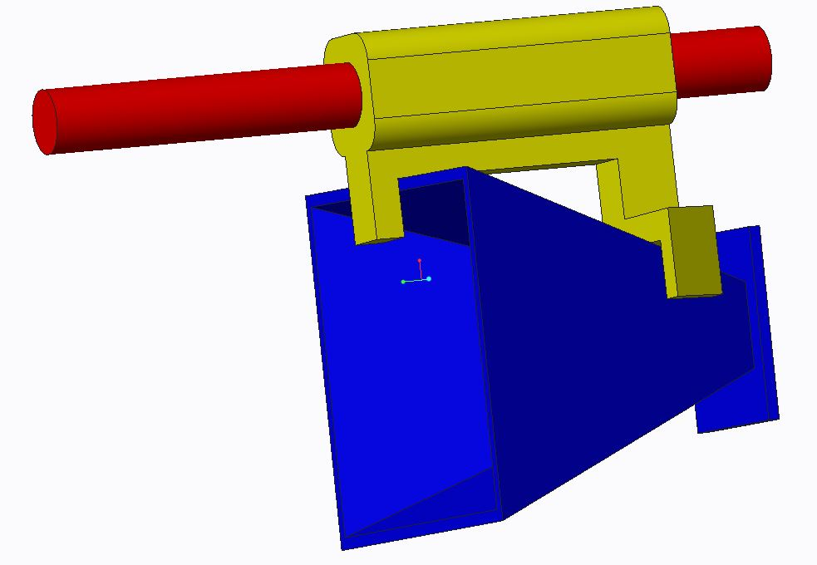
Horn Calibration – Option 2
Kegan stack

Slide 37
  Component Housing Update
  Migration of Electrical Components
  & Thermal Analysis
JULIAN RODRIGUEZ

Slide 38
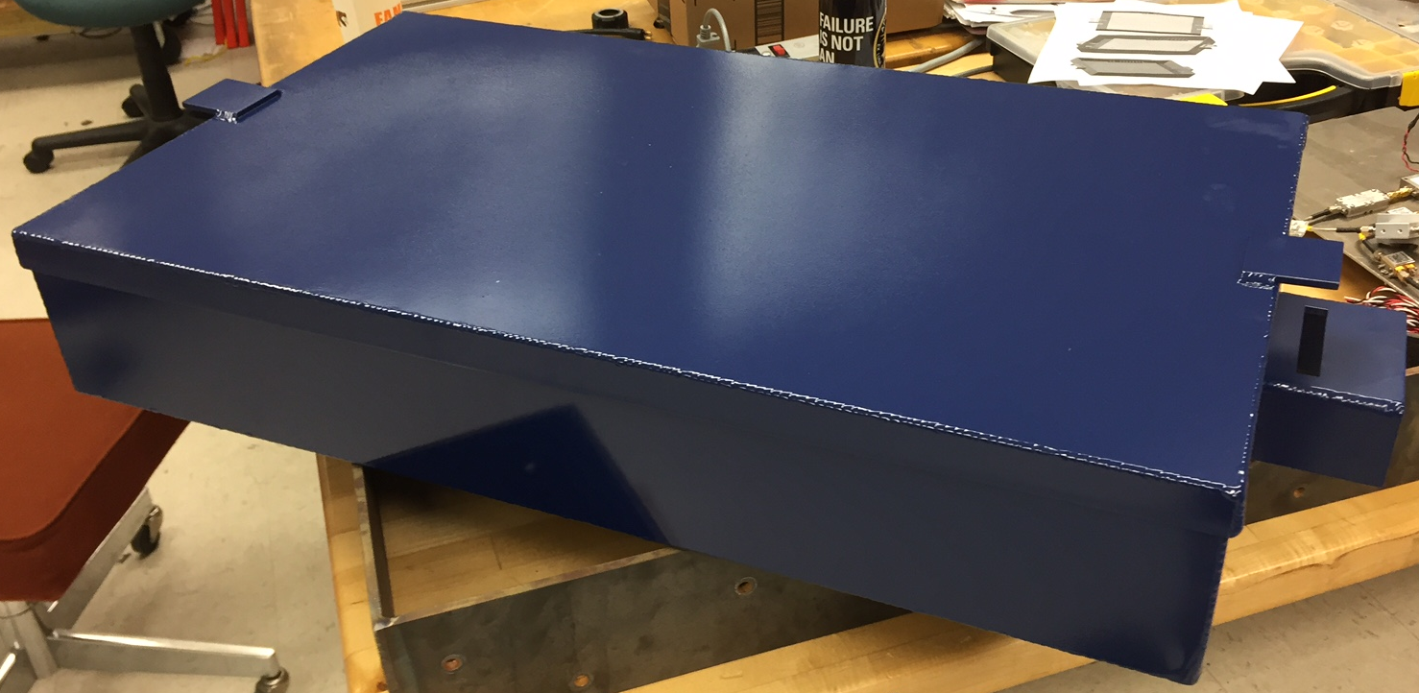
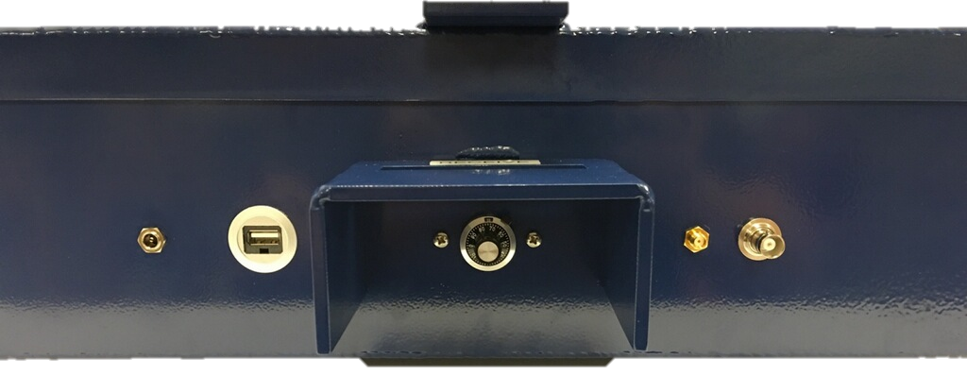
Component Housing - Update
Assembled
  Water jetted
  Welded
  Powder Coated
Machine Shop Error
  Redesign component layout
Install: Component tray with components re-wired
Install: Securable Latches
Weight: 12.9 lbs
  Before Components
Julian Rodriguez
Notes:
The design philosophy for the box was to first and foremost be accessible for the electrical engineers to conduct their testing as well as being as sealed from the outside environment as much as possible to protect from EMI, in which I will speak about in further detail later. Every input and output to and from the box goes through a panel mounted connection to not only enclose the box but also to make connections as simple as possible. The image above is a view which hides the walls to better show each connector installed into the box. Aluminum 6061 was selected due to its high electrical conductivity, strong weldability, and of course cost. The weight is approximately (12.9 lbs) compared to last year’s weight of (roughly 40lbs) down 67.75%. The latches on the side ensure the enclosure is properly shut when needed, and have the option to install padlocks if need be.

Slide 39
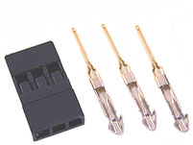
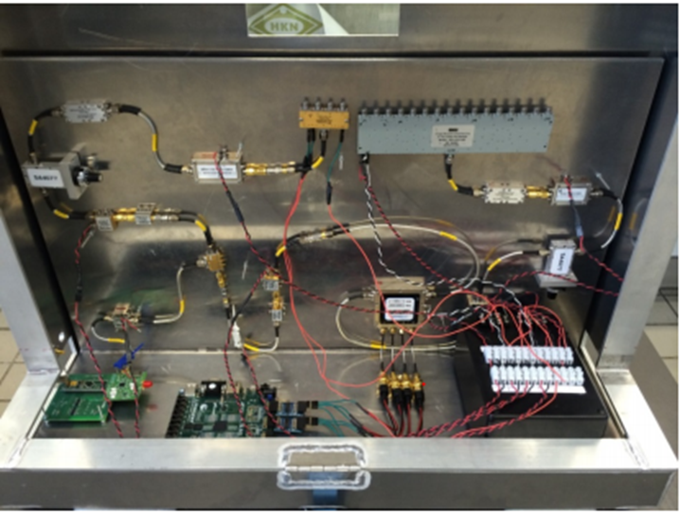
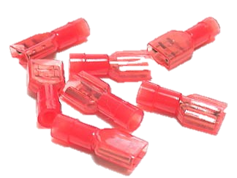
Component Housing - Rewiring
Approach:
  Minimize soldering
  Futaba J servo connectors
  22 AWG sleeve connectors
Improvements from last year:
  Less clutter, easier to follow
  Secure connections
Completion date: 2-3 days
Julian Rodriguez

Slide 40
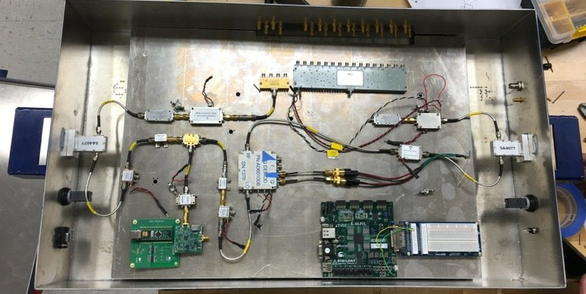
Migration – Electrical Components
Drop-in tray
  Removable
  Simpler to modify or change layout for the future
Status: In progress
  Bolting components to tray
  Slight delay due to machine shop error
  Completion date: 1-2 days
Improvements from last year
  More open area; easier to access for testing and modifying
  Cable management
Julian Rodriguez
Notes:
With the new dimensions for the box, some recalculations had to be made to determine the new thermal analysis. After changing the surface areas and thicknesses within the MatLAB code I created for thermal analysis, again using a Thermal Resistance Network, the total heat dissipation possible actually went up. Previously, the box would have only been able to dissipate approximately (155.37 W) compared to now with a value of (178.08 W). That is up by (14.6%). With this new heat dissipation, this translates to a factor of safety of (5.12).

Slide 41
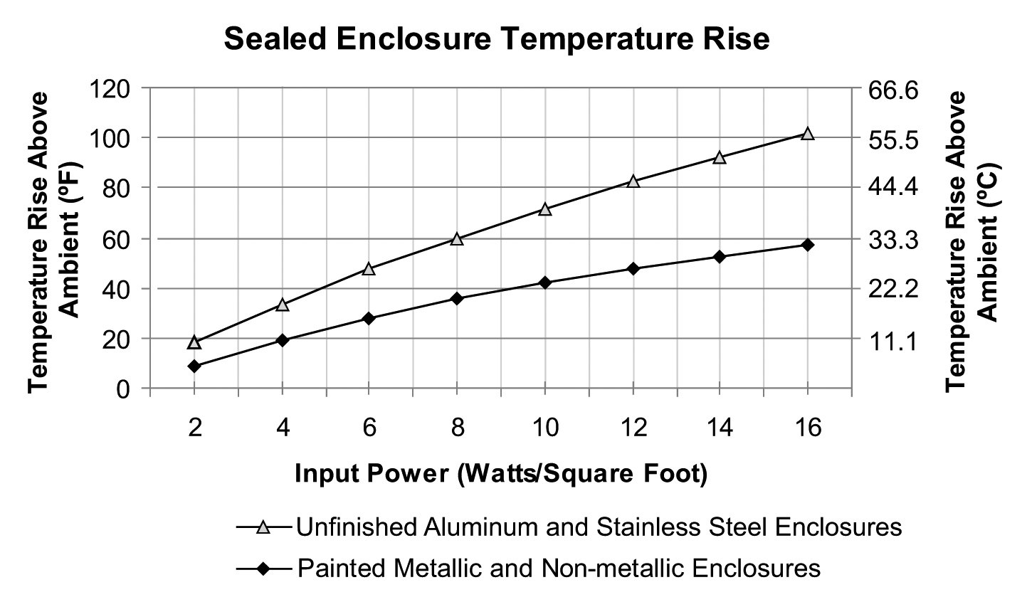
Thermal Analysis - Redefined
Previous temperature rise: 16.65° C (before paint)
Current temperature rise: 9.5° C (after paint)
  Radiant heat transfer efficiency
42% Enclosure temperature decrease
Highest enclosure temperature: 30.5° C
Most sensitive component failure temperature: 50° C
Julian Rodriguez
Notes:
Explain chart from Pentair’s (thermal and fluid mgmt. comp) technical document. With the surface area about 10.5ft^2 and total power supplied to components - is 34.8 W. The heat flux is around 3.32. Using the graph one can determine the temperature rise. State previous enclosure before paint, 16.65 increase = 37.65 C, assuming room temperature of 21 C. After paint, only 9.5 C increase = 30.5 C. This is due to an aluminum’s unfinished surface less efficient radiant heat transfer. This translates to 42% decrease on enclosure temperature. Since the most sensitive component’s failure temp is at 50 C, then it is deemed safe by a large amount (19.5 C)

Slide 42
  Conclusion & Schedule
Scott Nicewonger

Slide 43
Progress
Task | Last Presentation | Current Status
Signal Path Testing | In Progress | Complete
Matlab Signal Processing | Planning & 1st Iteration Code | 2nd , 3rd Iteration Code
FPGA Switching Control | Coded, Simulated | Debugging & Testing
FPGA Signal Processing | Pseudocode & Code Fragments | In development
Structure | Fabricated, Assembled | Waiting on parts for minor improvements
Horn Holders | Prototype fabricated, full order in machine shop queue | Fabricated, fully assembled
Laser Alignment Device | 2 models in consideration | Prototypes fabricated, in testing
Component Housing | Designed, waiting on material | Complete
KAYLEN NOLLIE

Slide 44



FAMU/FSU COE Synthetic Aperture Radar
Spring 2016 Timeline
4 days
Component Housing Fab & Assembly
3/14/2016 - 3/17/2016
8 days
Gen II Migration
3/18/2016 - 3/25/2016
5 days
RF Test Range Setup & Alignment
3/21/2016 - 3/25/2016
7 days
Delay Line Bench Testing
3/23/2016 - 3/29/2016
6 days
RF Range Testing
3/30/2016 - 4/4/2016
6 days
Neural Network Development & Testing (Strech Goal)
3/30/2016 - 4/4/2016
4 days
Data Documentation & Analysis
4/5/2016 - 4/8/2016
5 days
Closure & Gen III Hand-Off Plan
4/11/2016 - 4/15/2016
Final Report, Final Webpage, Notebooks
4/8/2016
Final Presentation & Open House
Presentation II
Operation Manual & Design Report
3/25/2016
4/1/2016
4/14/2016
2016
03/07
03/11
03/15
03/19
03/23
03/27
03/31
04/04
04/08
04/12
04/16
04/20
2016
3/13/2016
Today
4/4/2016
Spring "Break" End
Gen II Prototype Verified
3/29/2016
Gen II Prototype Complete

Slide 45
Questions?

